Slide 1

Abra-Bawk-Dabra
Kelly Abramowitz, Jack Shen, Ben Filbert

Slide 2
Overview
Takes the role of a chicken wizard
Tetris-esque puzzle to fight a dragon
Collects gems upon line-clearing to power up attacks

Slide 3
Specifications
PC game
Using GameMaker
Lighthearted & Humorous puzzle game

Slide 4
Plot
Chicken Wizard
Wants to be human again
Fight the dragon to get the potion

Slide 5
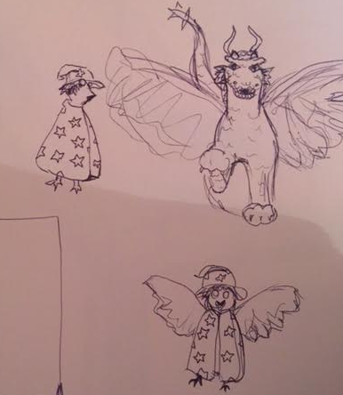
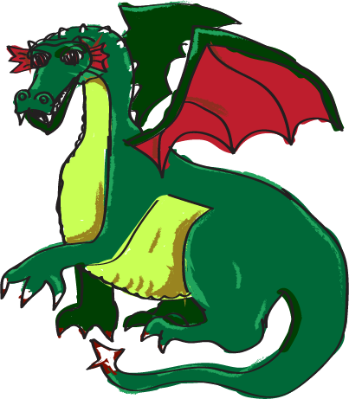
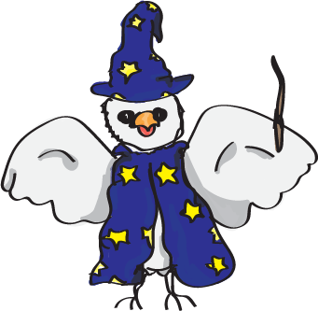


Art & Characters
Happy & Colorful
Clucky (PC)
Spike (Boss)

Slide 6
Gameplay - Puzzle
Defend against boss attacks by stacking a barrier (not too high!)
Have attack and healing powers, filled up through collecting gems.
Defend against fireballs that do 20 damage
Defeat the dragon

Slide 7
Controls
[A][D]: Move block left/right [W]: Rotate block [S]: Increased fall speed [SPACE]: Drop block [C]: Hold Block [1][2][3]: Utilize powerup

